Slide 1
Derivatives with a Computation Graph
Coursera
Notes:
Previously we used the computation graph to compute the value of J.
Here we will understand how we can use the computation graph for derivative calculations.

Slide 2
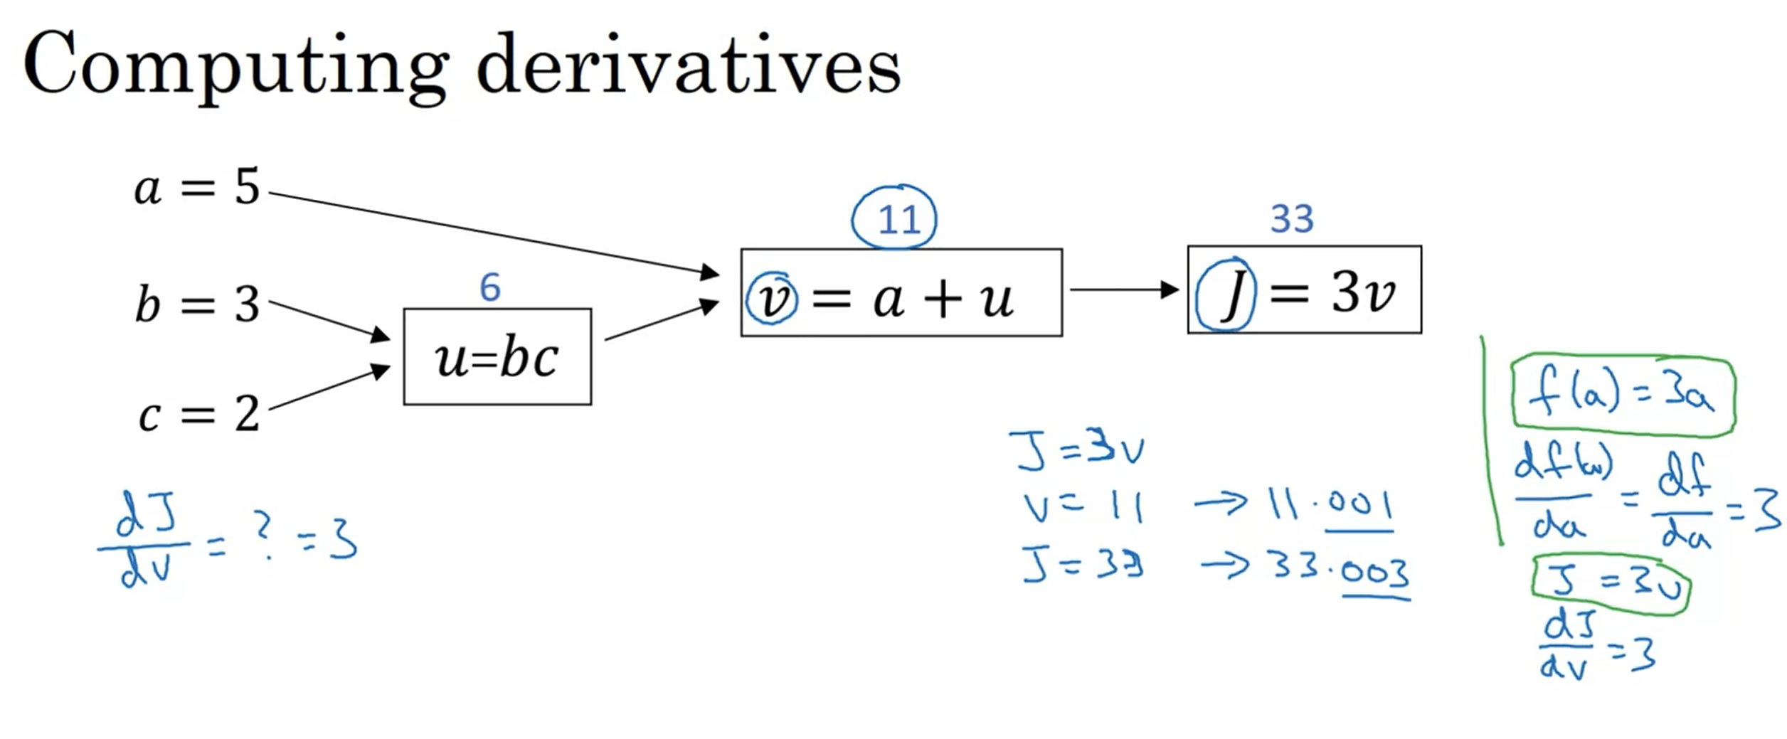
Derivatives with a Computation Graph
Notes:
Here we are trying to compute the derivatives of J with respect to v.
Q: What is that ?
A: We see that if we change the value of v by a little how will the corresponding value of J will change
Here J is defined as 3v & v is 11
Lets say if we nudge v a little, than J which is currently 33 will get pumped up to 33.003
0.003/0.001 = 3 times increase
That increase is the derivative & it is 3.
This is very analogous to example what we have seen previously of f(a) function.

Slide 3
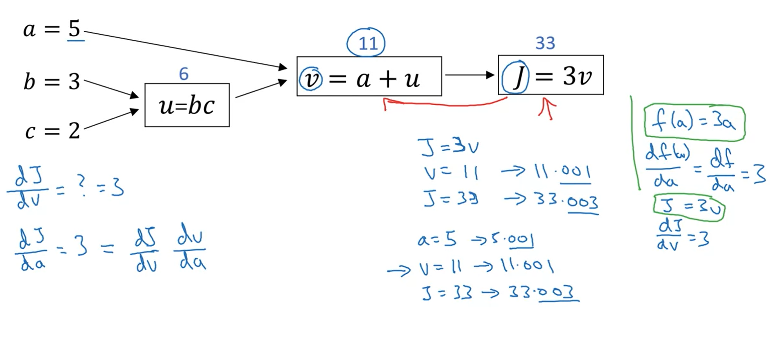
Computing Derivatives
Notes:
In the terminology of back propagation, we see that if we compute the derivative of final output variable J with respect to v, it is one step of back propagation.
Now lets see the change in J with respect to change in a which is one step backward further. In notation, it will dj/dv
Dj/da : if we p[ump up the value of a how does it pumps up the value of j
So here, we see that if increase the value of a from 5 to 5.001, the corresponding change in the value of J will be 3 times the change hence the derivative of J with respect to a is 3.
Since the change in v due to change in a is 1 times. Change in a propagate to the change in c & that change propagates right towards J
One way to break it down is, that if we change a, it will change v & through changing v wil change J The net change to J with nudging the value of a is that first by changing a we end up increasing v which is determined by dv/da, than tha change in c will cause the change in J which is determined by dj/dv
In calculus it is called the chain rule.
“if a affects v affects j, than the amount that J changes when you change a is = the product of what v changes with change in v times how much J changes
When v changes ”
We see in the calculations if a changes by 0.001, v changes by the same amount so dv/da = 1 & than with the change in v of 0.001 J changes by 0.003 hence the dj/dv is 3
So a change of value in a will cause a change of (1)*(3)*(change in a) in J

Slide 4
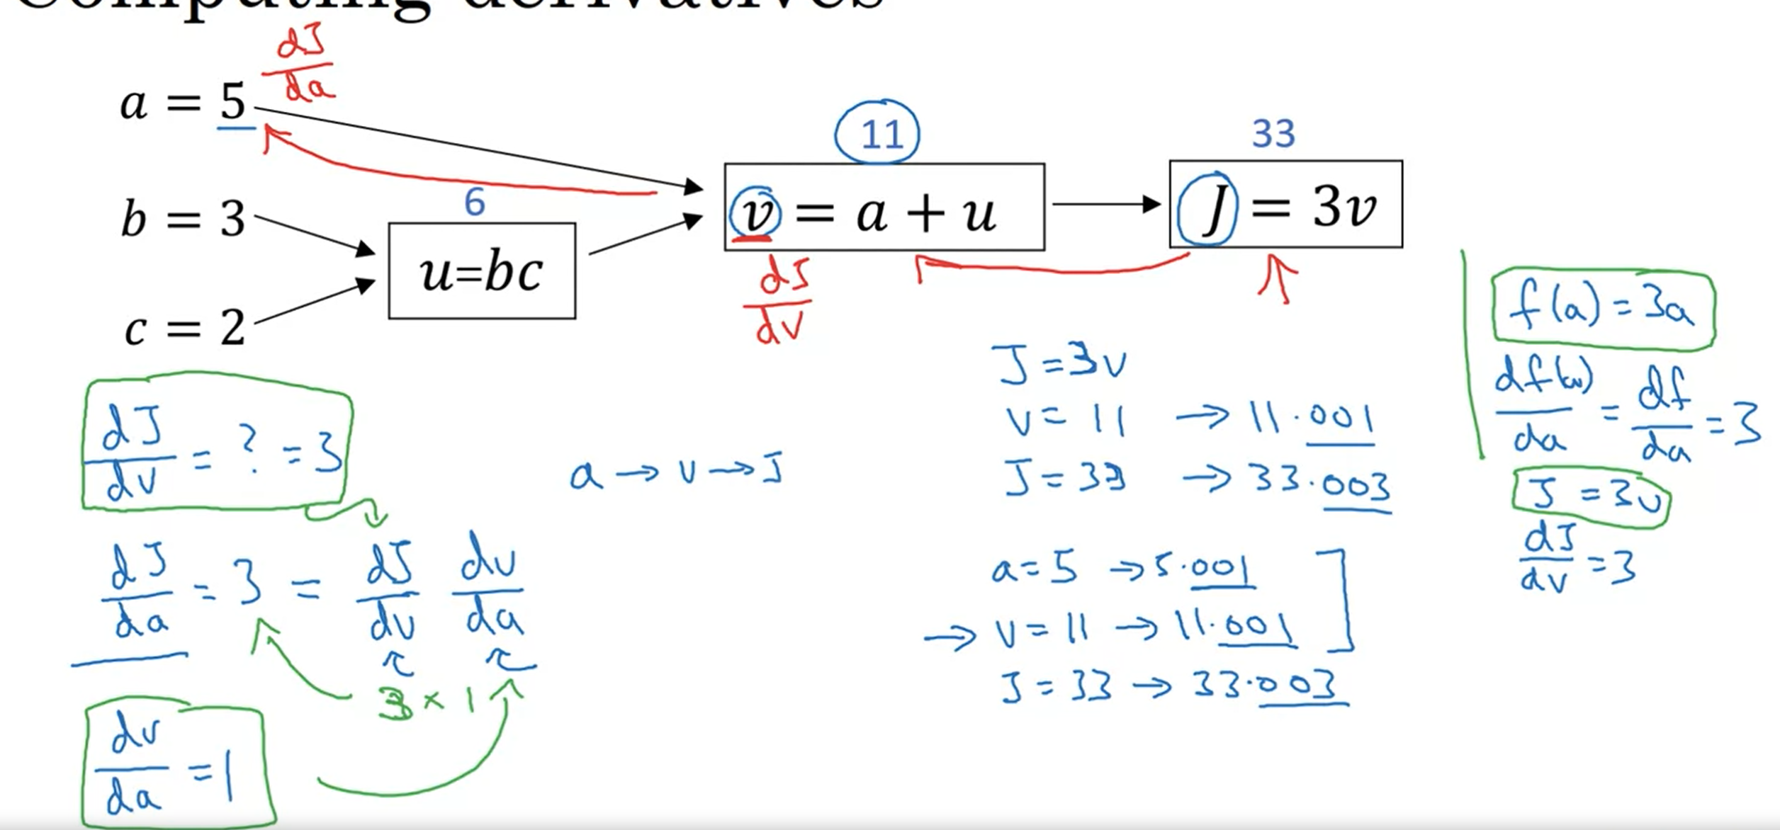
Computing Derivatives
Notes:
Dv/da = 1
& dj/dv = 3
The product of these 2 gives the correct change in v for a change in a.
This illustration shows that computing Dj/dv will help us compute dj/da using chain rule mama

Slide 5
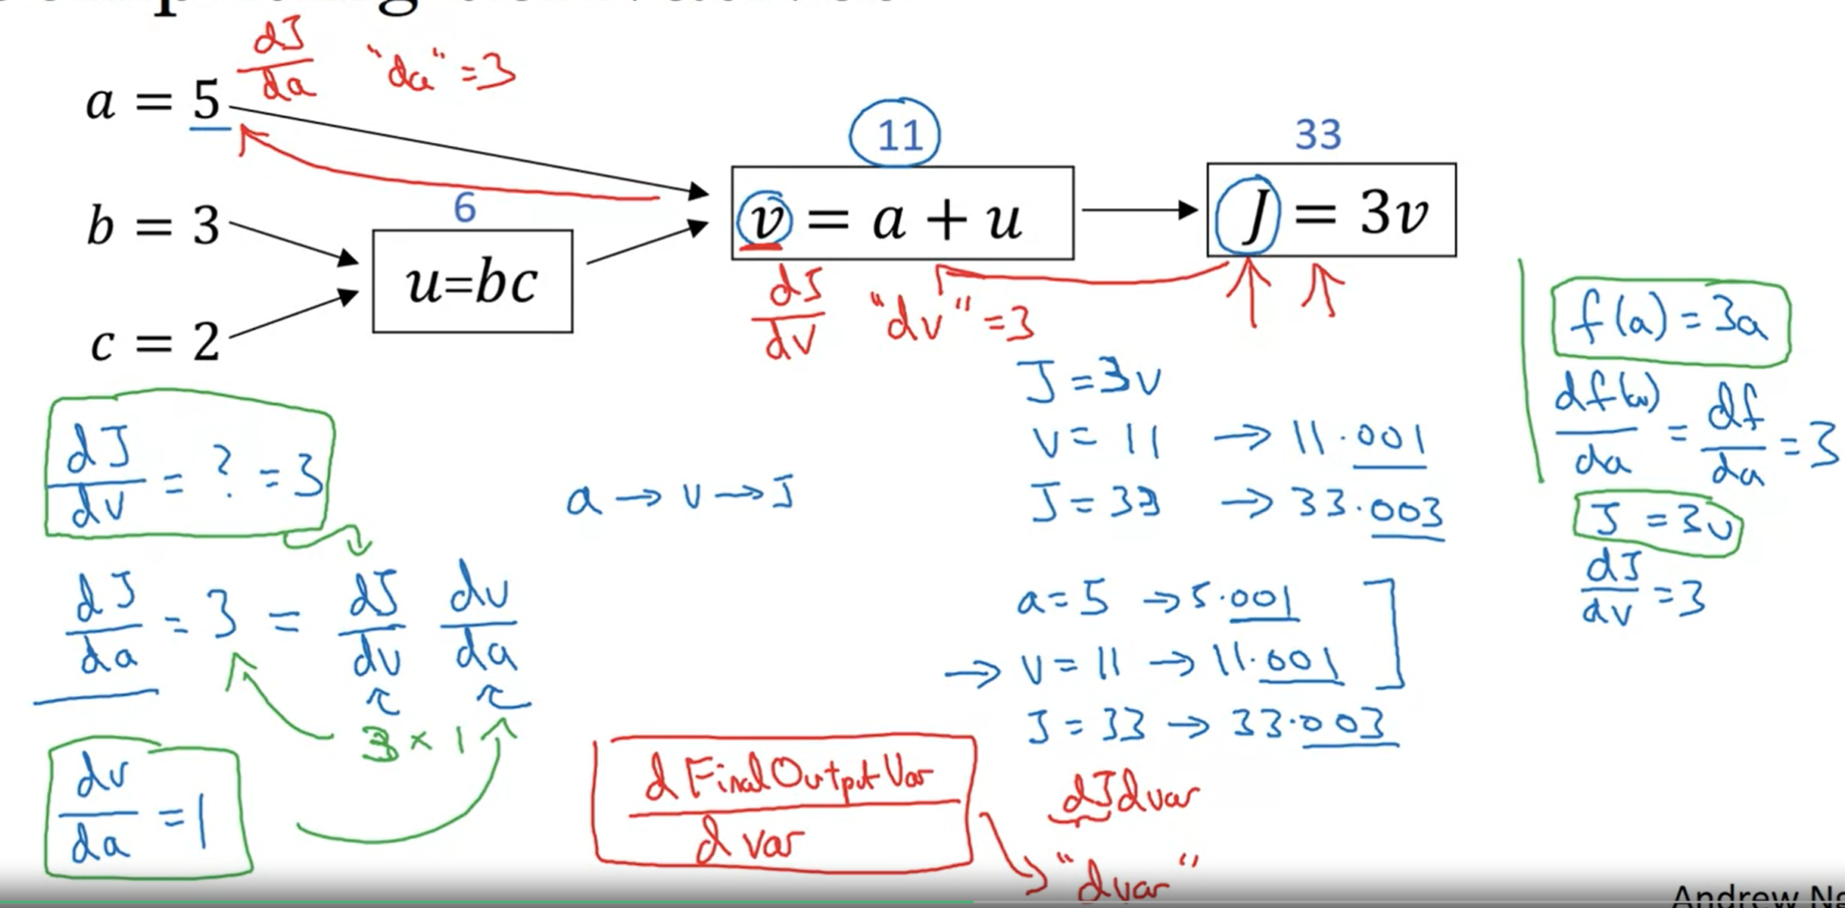
Coding Notation.
Notes:
When you are writing the code for to implement back propagation gradient descent, we care about the final output variable that we want to optimize.
In this case, the final output variable is J
In lot of the computations, the derivative of final output variables with respect to different intermediate variables.
In python, we should write in a new notation, dvar in order to represent the derivative of final variable w.r.t to intermediate variables.

Slide 6
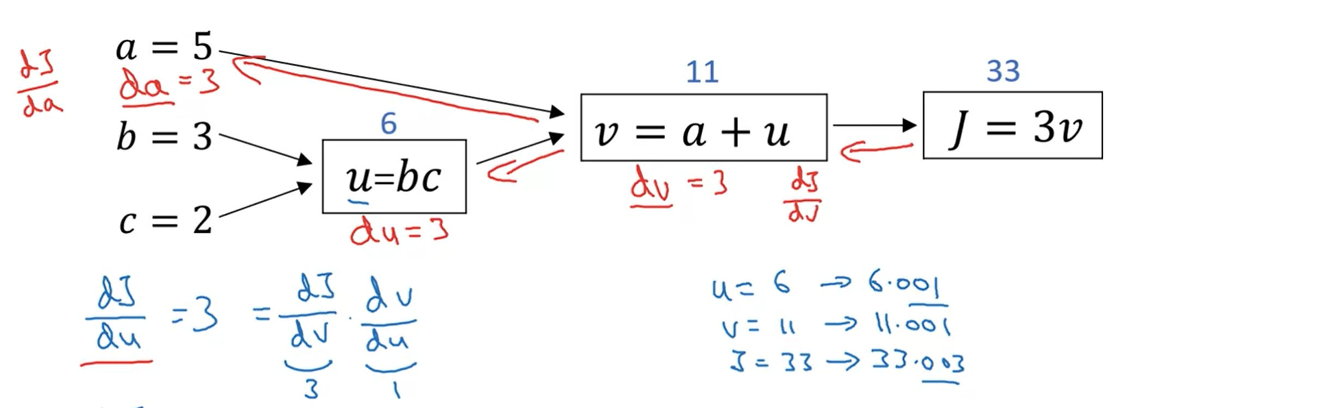
Computing Gradient – Computing u
Notes:
Recap: So far, we have gone from J to v to get dj/dv which we say as dv, than da
Here in this slide, we focus on u. using the similar process.

Slide 7
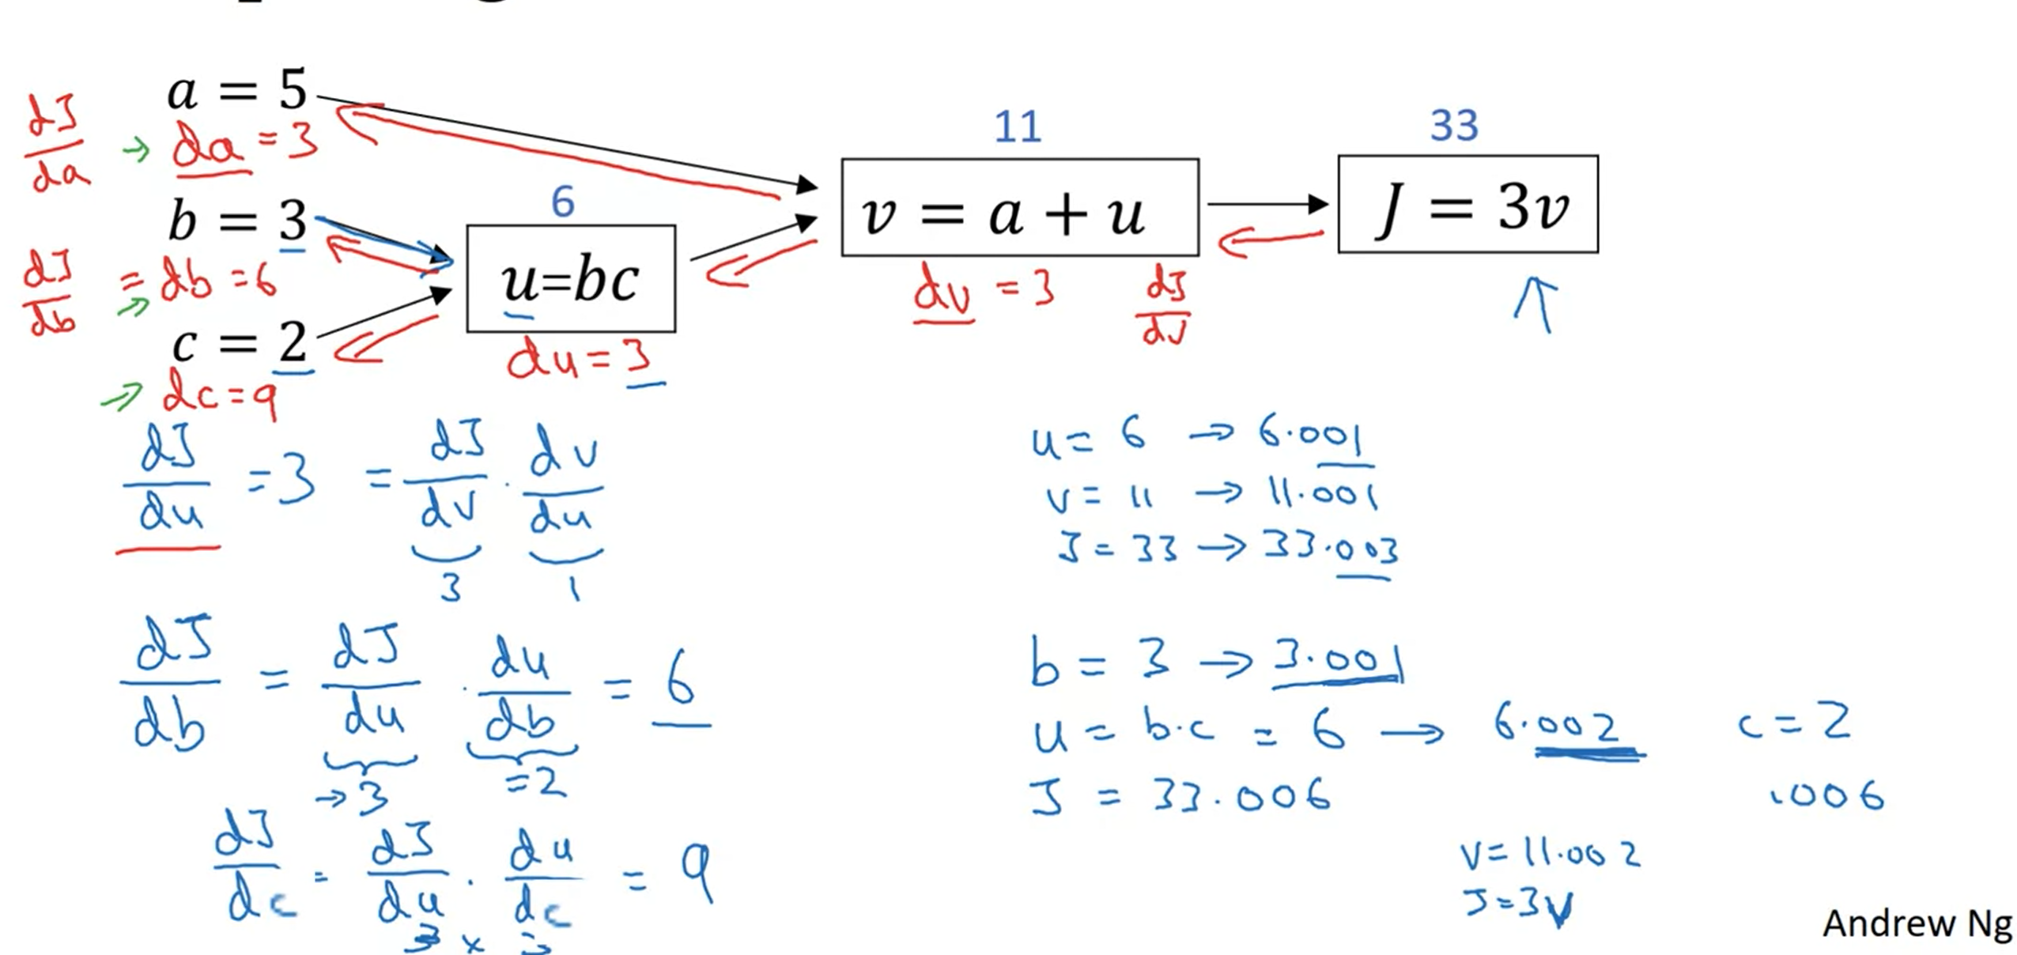
Computing Gradient – Computing b & c
Notes:
Here we are focusing on b.
Using the chain rule using calculas, we can write it as a product of 2 things, change in b will first affect u & u will affect J which we have computed already.
Here du/db = 2
We know that y dj/du = 3
This means that if u changes by 0.002 than it will change v by 0.006
Similarly , we compute for c.

Slide 8
Computing Gradients – Takeaway
The most efficient way to compute the gradients is through left to right & right to left computations.
Forward to compute the cost function J
Backward function to compute the derivatives.

